Slide 1
2018-19
Title I
Parent Meeting
Edison High School

Slide 2
AGENDA
TITLE I PROGRAM OVERVIEW
PARENT RIGHTS UNDER TITLE I
PARENT INVOLVEMENT
SCHOOL ACHIEVEMENT DATA
SINGLE PLAN FOR STUDENT ACHIEVEMENT
TITLE I FUNDING
TITLE I PARENTAL INVOLVEMENT POLICY
SCHOOL-PARENT COMPACT

Slide 3
Title I
Provides additional academic support and learning opportunities for students
Helps ensure that all students meet the California COMMON CORE STATE STANDARDS

Slide 4
Goals of Title I
Increase academic achievement by
1. Providing direct instructional support to students
2. Providing professional development to teachers
3. Promote parent education and involvement

Slide 5
Parent Rights
Review the school’s achievement data
Ask for meetings and trainings
Review and modify the school’s Title I Parental Involvement Policy and School-Parent Compact
Review the parent involvement plan and activities included in the Single Plan for Student Achievement

Slide 6
Parent Involvement
School Site Council
Student Achievement
The School Site Council (SSC) provides parents with an opportunity to be involved in the academic program of the school/
Title I law requires that schools and families work together to increase student achievement.
SPSA
ELAC
The SSC develops, monitors, and evaluates the Single Plan for Student Achievement to implement programs and services that support students

Slide 7
School Performance Data
Smarter-Balanced Assessment Consortium (SBAC) for English Language Arts and Mathematics
Measures of academic progress (MAP) for Reading/Math

Slide 8
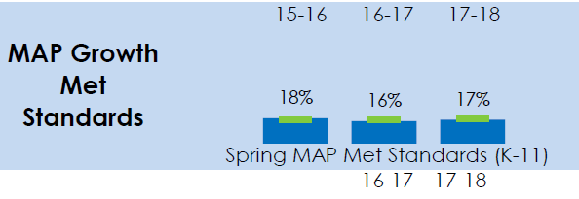
2017-18 MAP Results- Reading/Mathematics
Overall decrease of 1% of students who met standards in English Language Arts from Spring 2017 to Spring 2018
Overall increase of 1% of students who met standards in MATH from Spring 2017 to Spring 2018

Slide 9
2017-18 SBAC results: ELA
6% Growth

Slide 10
2017-18 SBAC results: MATH
3% Decrease

Slide 11
Single Plan for Student Achievement (SPSA)
Description of core and supplemental programs
Description of instructional strategies and interventions to assist struggling students
Goals and strategies to address student academic needs
Professional needs and activities
Coordination of fiscal resources
Annually evaluate the program goals

Slide 12
Title I Funding
Schools are allocated funds based upon the percentage of students receiving free or reduced lunch.
Schools are ranked according to this percentage and receive a certain amount of money per student.
One percent of the school’s total Title I budget is for parent involvement activities.
Schools in Program Improvement must also set aside funds for professional development.

Slide 13
Title I Funding
Total Title I Allocation:
$436,318
Expenditures include:
Parent Involvement…$9,598
Instructional Expenditures…
$426,720

Slide 14
Parental Involvement Policy
Every Title I school, in collaboration with parents, must prepare a site-level parental involvement policy.
The Policy describes how the school will involve parents in a meaningful, ongoing, and timely way.
The Policy also describes how parents will be involved in the planning, review, and improvement of the school’s Title I program and activities.

Slide 15
School-Parent Compact
The Compact describes how the school and parents share the responsibility for student achievement.
It is developed in collaboration among parents, teachers, and students.
The Compact is distributed annually with the Title I Parental Involvement Policy.

Slide 16
Questions?

